Slide 1
Identifying your 20 Aquatic Birds 1. First, recruit a trusted parent to supervise. 1. Get a piece of paper and number 1-20 2. Go through the slides and write down your educated guesses 3. Have mom or dad correct it

Slide 2
1. Take the quiz until you get 100% 2. Take a selfie of yourself and your trusted parent in the same picture, both giving a thumbs up, with the last slide in sight. 3. email me the picture

Slide 3
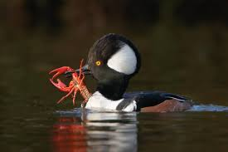
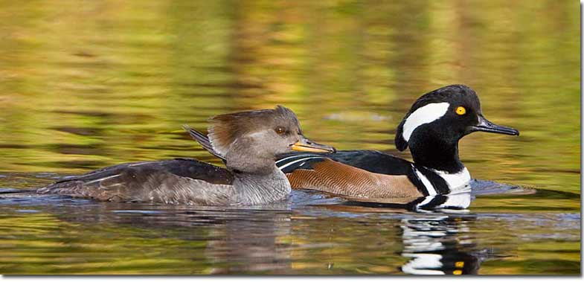
1.

Slide 4
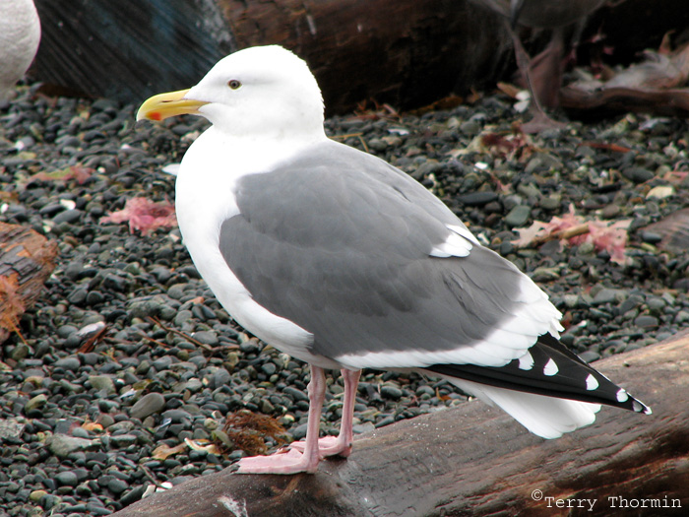
2.

Slide 5
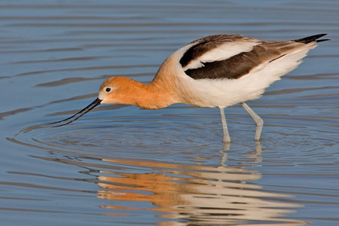
3.

Slide 6
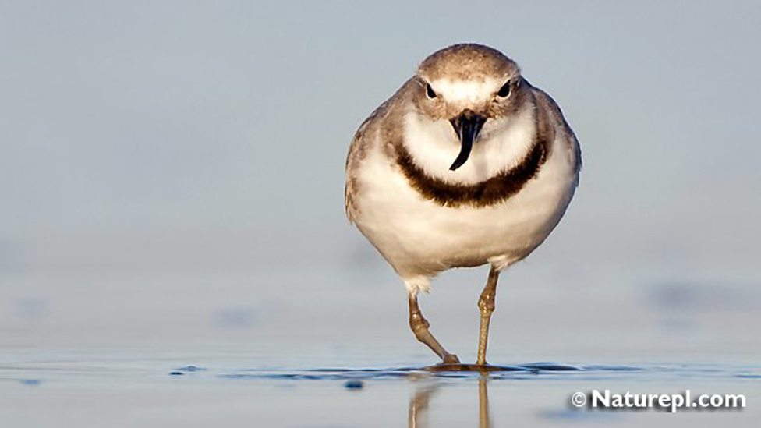
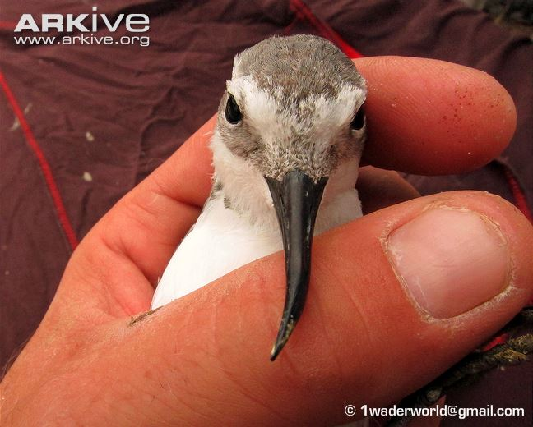
4.

Slide 7
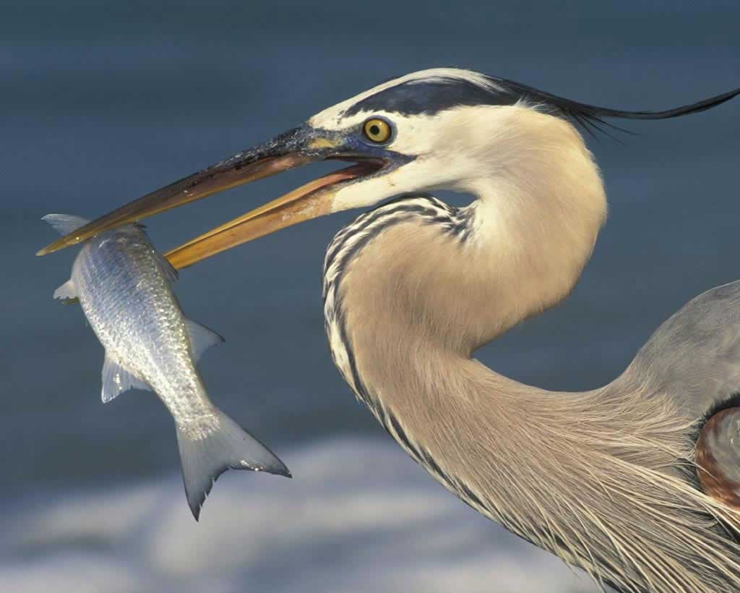
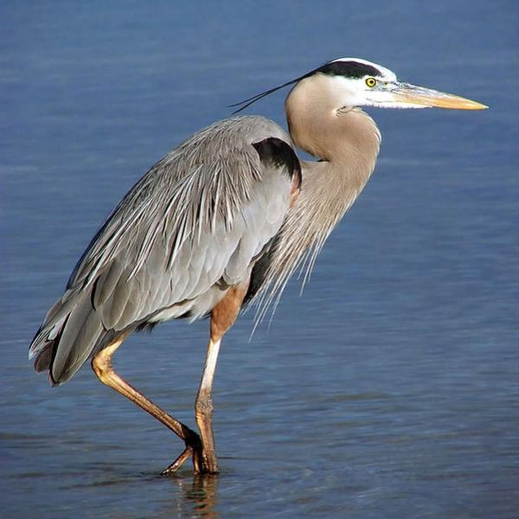
5.

Slide 8
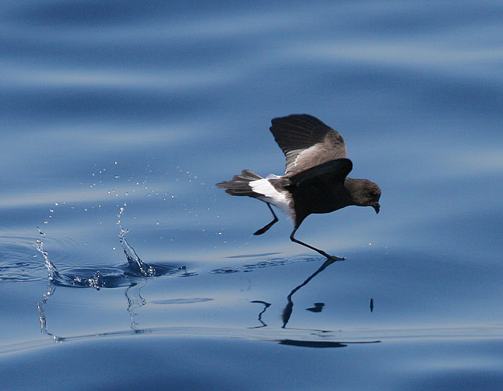
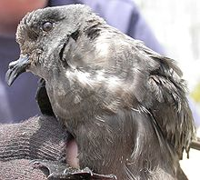
6.

Slide 9
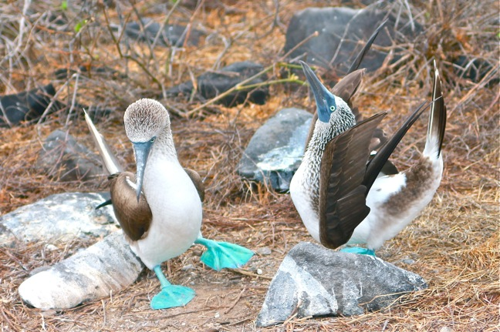
7.

Slide 10
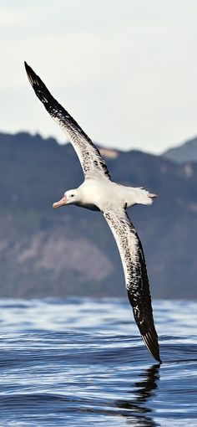
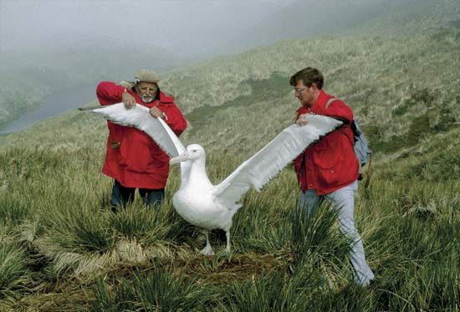
8.

Slide 11
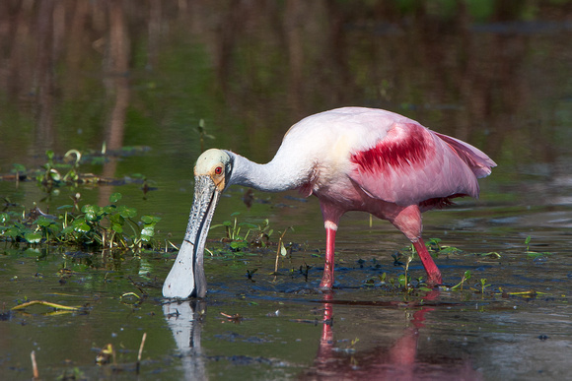
9.

Slide 12
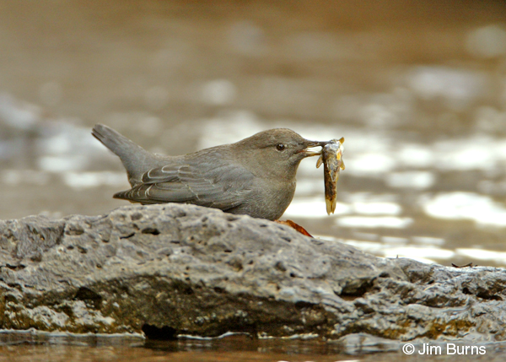
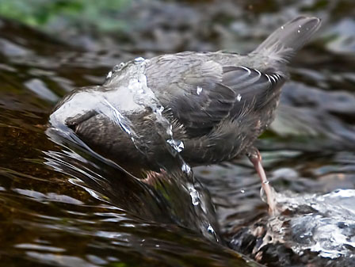
10.

Slide 13
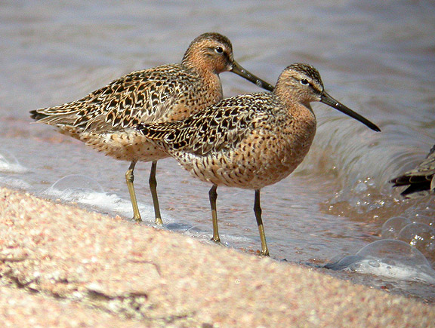
11.

Slide 14
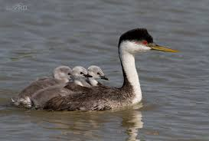
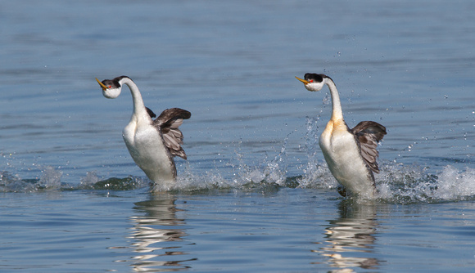
12.

Slide 15
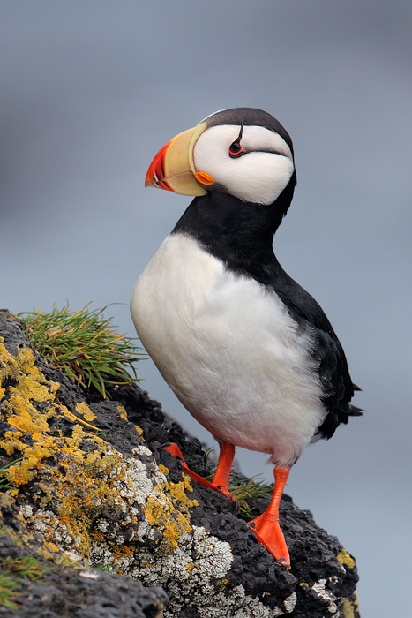
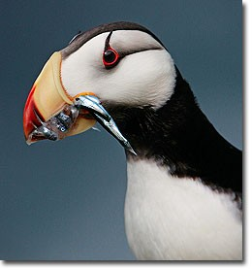
13.
I love me some smelt

Slide 16
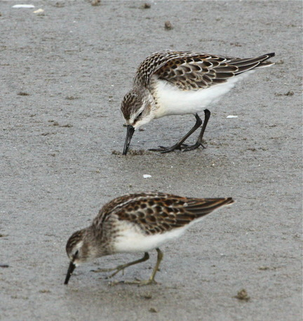
14.

Slide 17
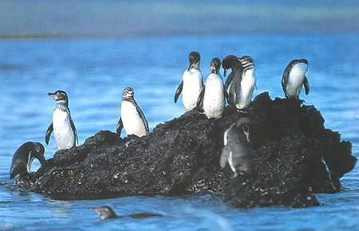
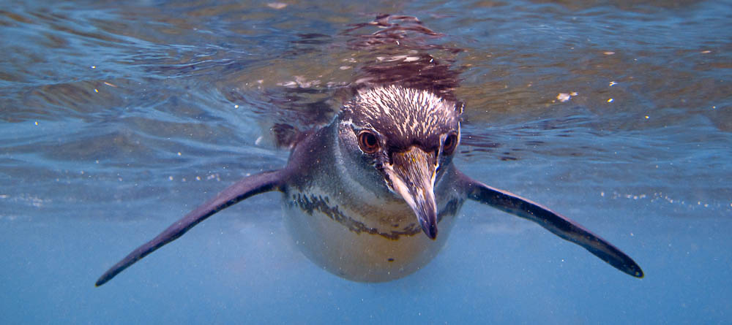
15.

Slide 18
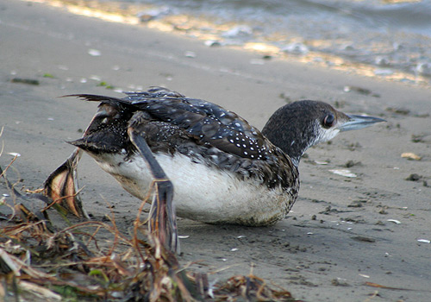
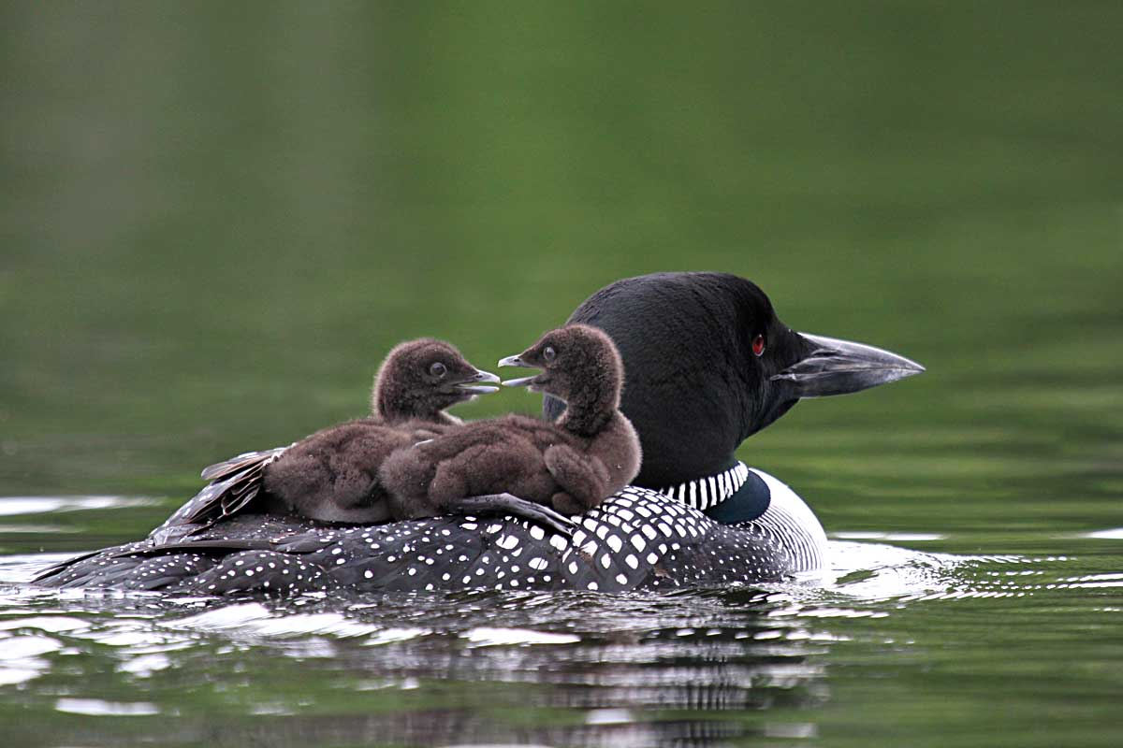
16.

Slide 19
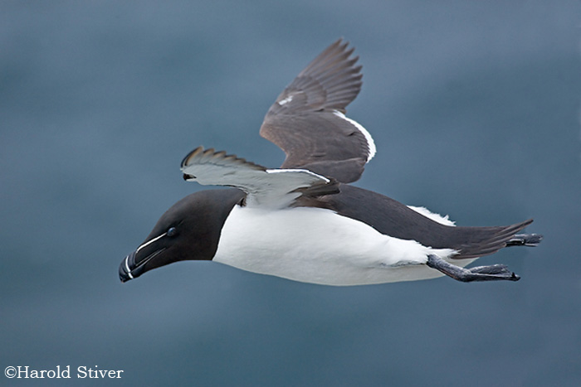
17.

Slide 20
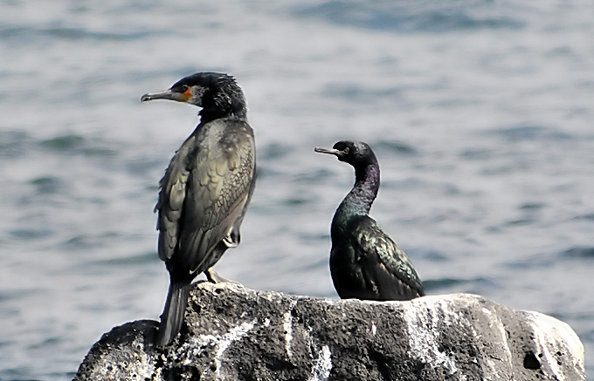
18.

Slide 21
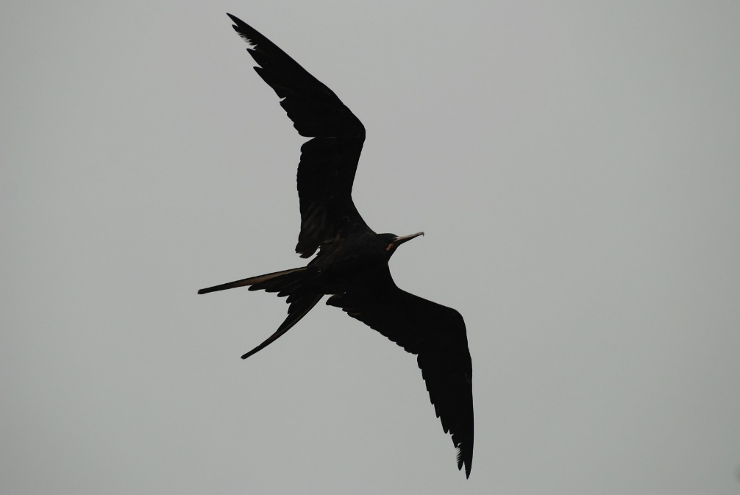
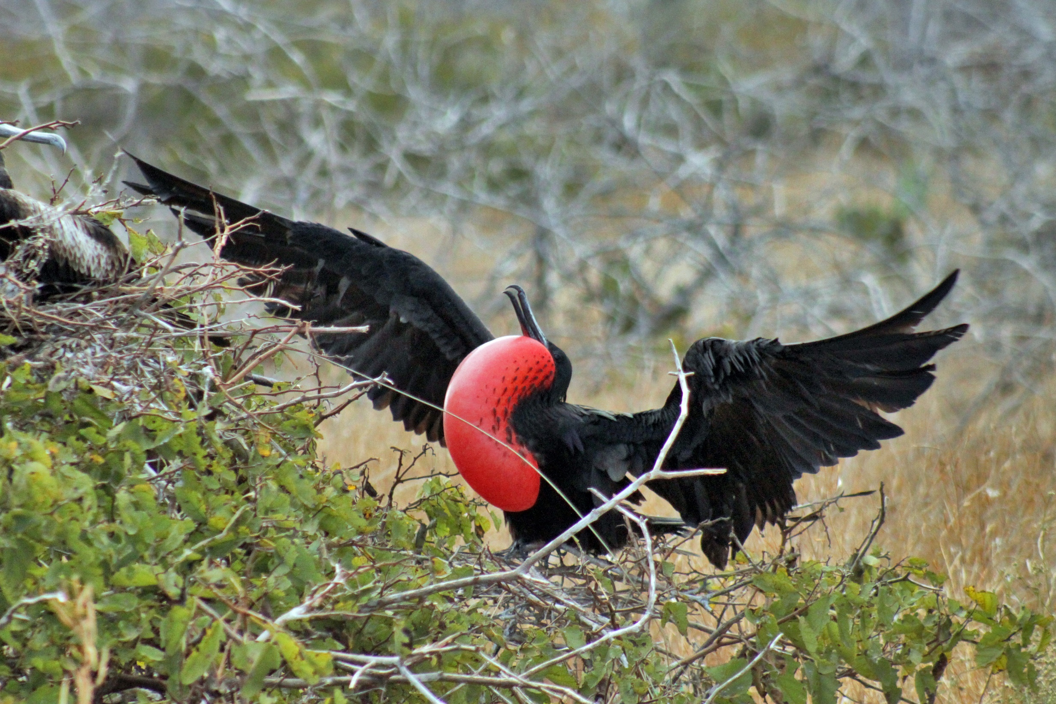
19.

Slide 22
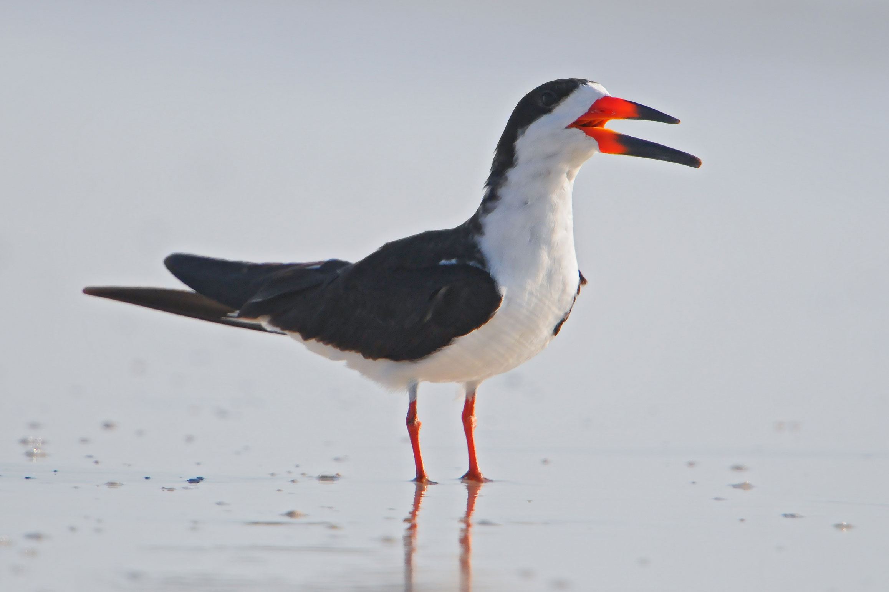
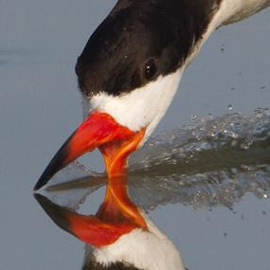
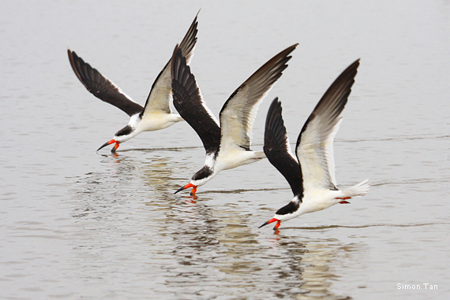
20.

Slide 23
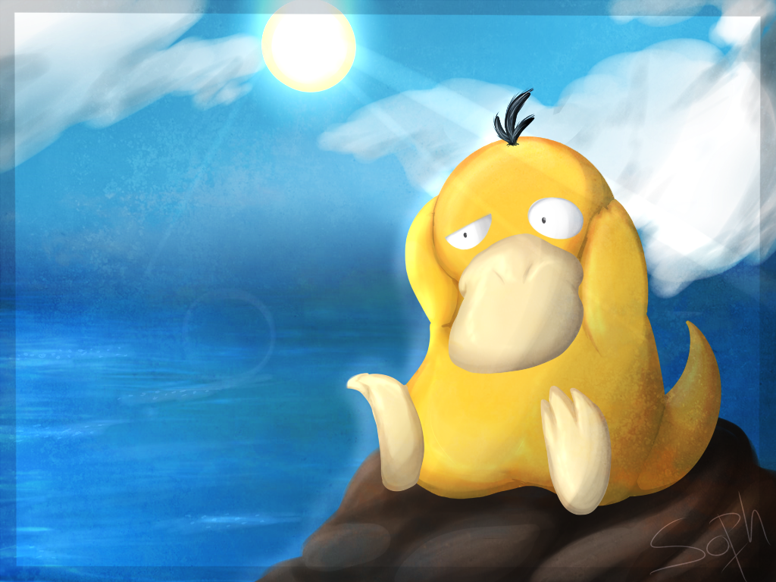
Let’s see how you did… hand your paper over to a trusted adult so they can grade it. The next slide will show the answers. If you missed any, take it again.

Slide 24
Answers 1. hooded merganser 2. glaucous-winged gull 3. American avocet 4. wrybill 5. great blue heron 6. storm petrel 7. blue-footed booby 8. wandering albatross 9. roseate spoonbill 10. American dipper 11. dowitcher 12. western grebe 13. horned puffin 14. western sandpiper 15. Galápagos penguin 16. common loon (diver) 17. razorbill 18. pelagic cormorant 19. magnificent frigatebird 20. black skimmer

Slide 25
HEY SEÑOR ROBLES,
I EARNED 100% ON THE BIRD IDENTIFICATION QUIZ!!!

