Slide 1
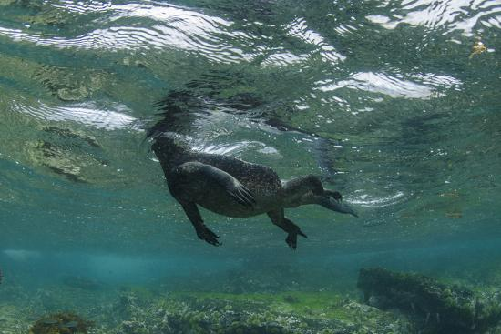
MARINE IGUANAS 1. The world’s only marine lizard

Slide 2
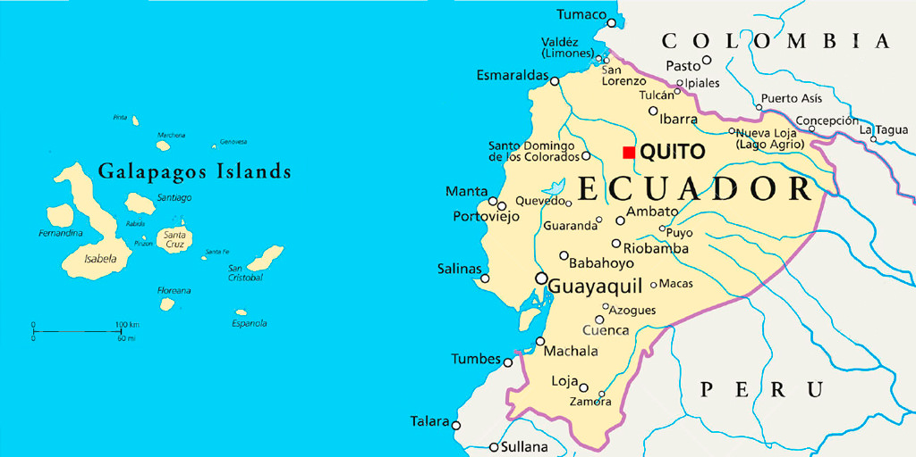
2. a. Lives in only one place: The Galapagos Islands. b. Not because these islands have special environmental features found nowhere else on Earth, but because their ancestors (tree iguanas) came from South America and evolved into their present form.

Slide 3
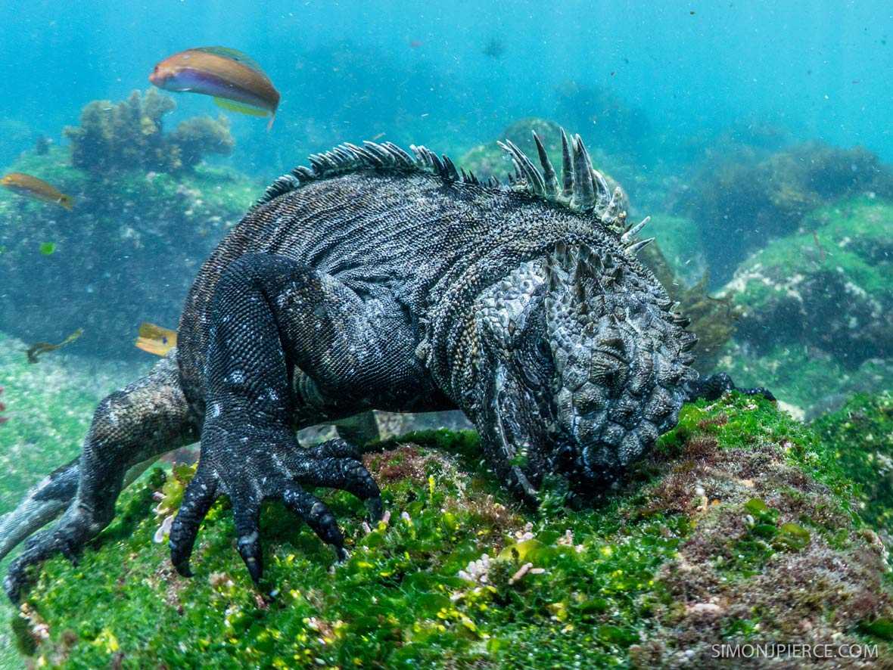
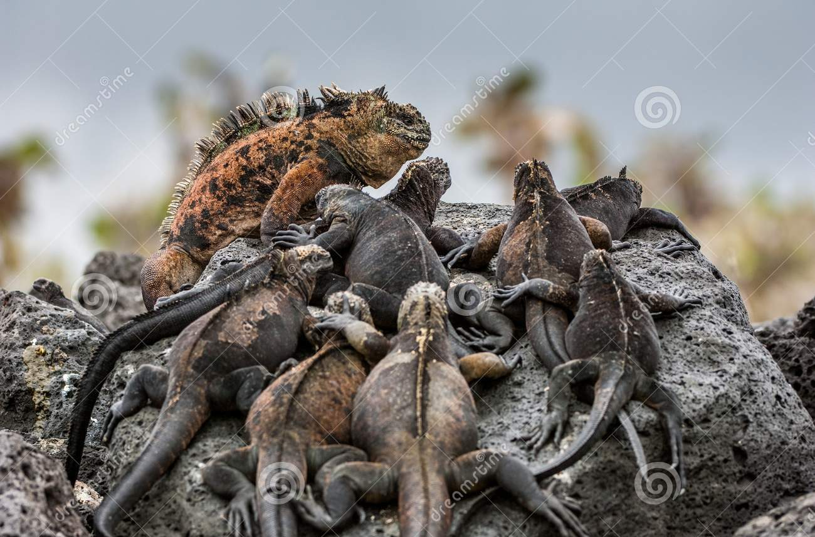
3. All they eat is seaweed / algae (herbivorous) 4. Being ectothermic (“cold blooded”) means they can only stay submerged in the cold water for a limited time. 5. Males larger and brighter colors, has a harem of females.

Slide 4
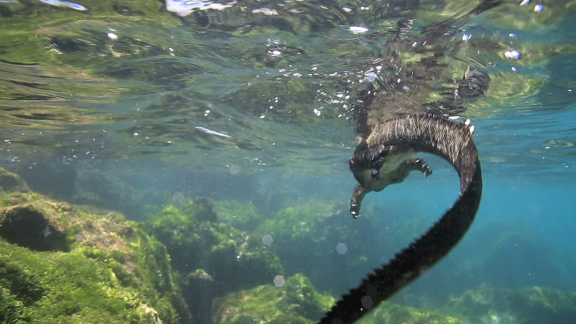
8. a. Shorter snout to scrape algae off rocks b. Large strong claws to hold onto rocks in waves c. Black color to camouflage on lava rock d. Laterally flattened tail for more surface area

Slide 5
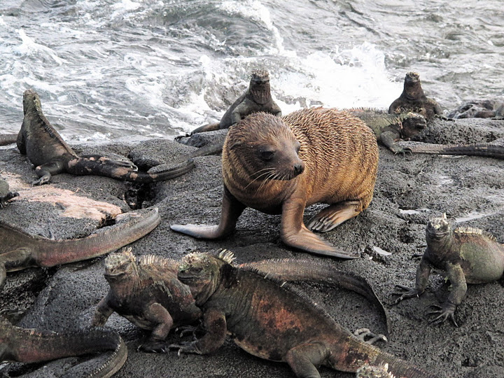
9. Sea lions are endothermic (“warm blooded”) so can stay in the cold water longer.

Slide 6
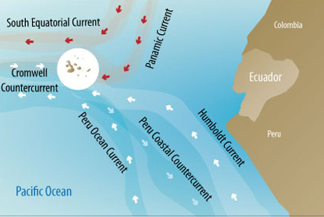
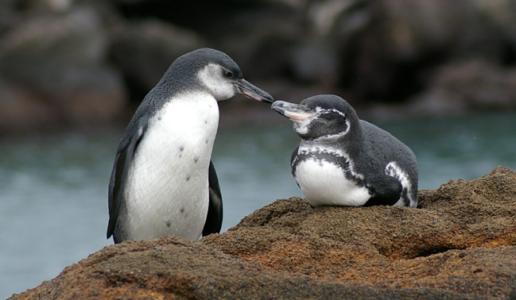
10. Note that the Humboldt Current brings cold water from the Antarctic region. This explains why there is such a thing as an equatorial penguin native to the Galapagos.

Slide 7
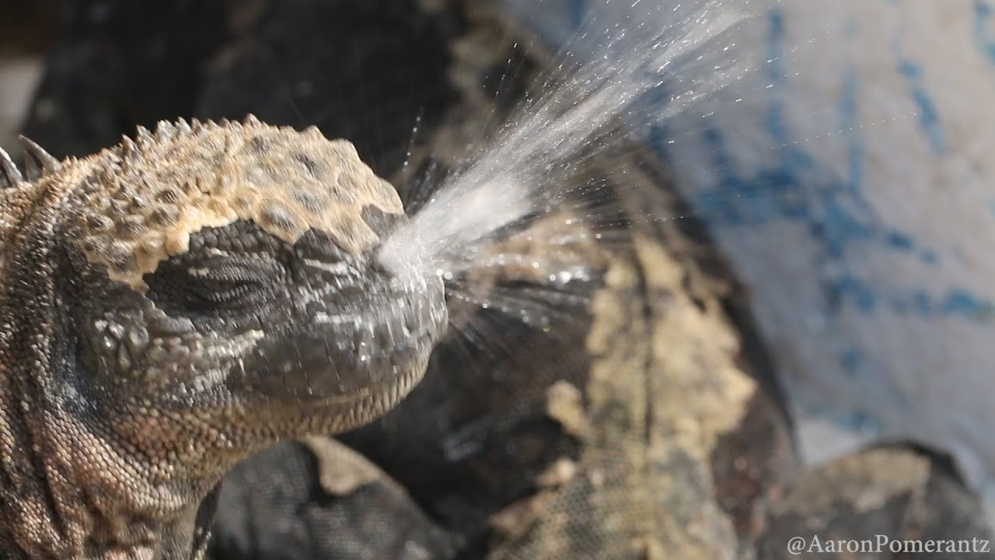
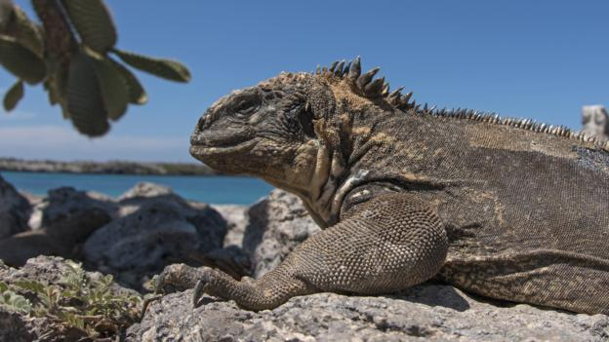
12. You learned about this in the Salinity unit. 15. Head bobbing = non-verbal communication.

