Slide 1
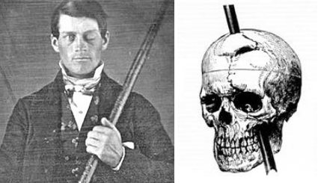
Phineas Gage videos Recreation https://www.youtube.com/watch?v=NFO6ts6vZic Full story with crayon drawings https://www.youtube.com/watch?v=X4fGlny5cPg Harvard https://www.youtube.com/watch?v=yXbAMHzYGJ0 Musical Lego version https://www.youtube.com/watch?v=_nikOxNfjqs

Slide 2
Briefly describe the incident… What’s he holding? Why’s he winking?
Sept. 13, 1848 near Cavendish, Vermont. While preparing a boulder to be dynamited, an explosion occurred unexpectedly which launched a 3’7” tapping iron through Gage’s head.
The 13.5 pound tapping iron
His optic nerve was severed

Slide 3
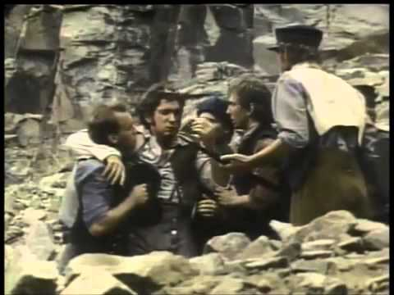
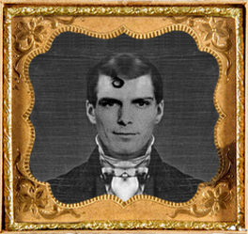
Gage’s personality & occupation before the accident?
Intelligent, well-balanced, modest, reliable, able to make careful decisions
He was the foreman of a railroad construction crew

Slide 4
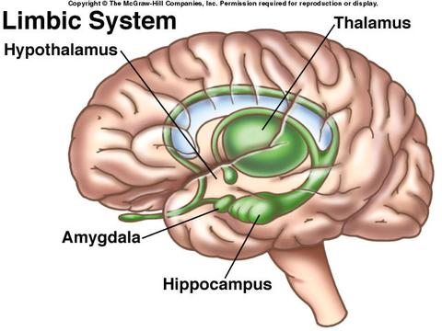
Two areas of the brain affected, along with their functions
Limbic system, center of emotions
Frontal lobe, seat of reasoning

Slide 5
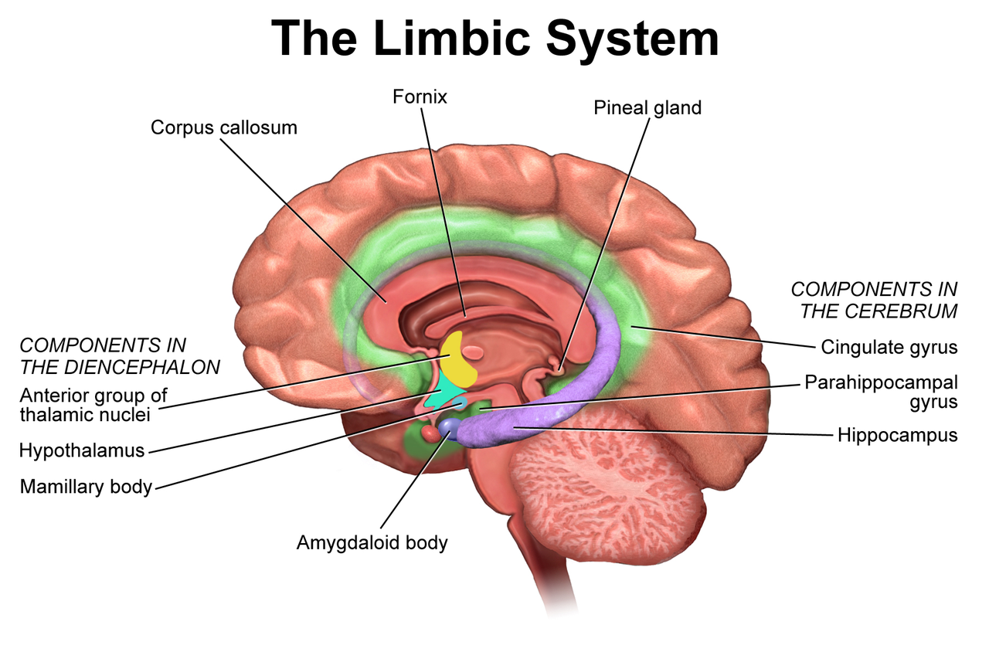
The limbic system is located on both sides of the thalamus, immediately beneath the medial temporal lobe of the cerebrum primarily in the midbrain.

Slide 6
Why so little pain?
Endorphines, the brain’s “natural morphines” diminish pain by blocking the pain receptors on the post-synaptic neuron.

Slide 7
How did this affect Dr. Harlow?
He had the skull exhumed, and compared the injury to his notes on Gage’s personality changes.
Came to realize that the front of the brain (frontal lobe) controlled personality
Stated that the accident caused a separation between the “intellectual faculties and animal propensities.”

Slide 8
“Whole brainer?”
Two schools of thought at the time: Whole Brainers who believed a “vital force” connected the entire brain, and that any part could do anything and Localizers believed in localized functions.
Modern understanding is primarily “localized”, but with some plasticity and sharing

Slide 9
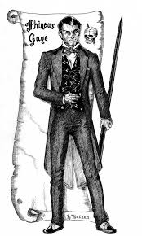
Personality after the accident? Did he get his old job back?
Became erratic, unpredictable, emotionally unbalanced, vulgar, lack of self control.
Decreased ability to communicate with other people, although affinity for animals
Didn’t get his job back (Benji got it), ended up working circus sideshows
Finally went to Chile to drive stage coaches

Slide 10
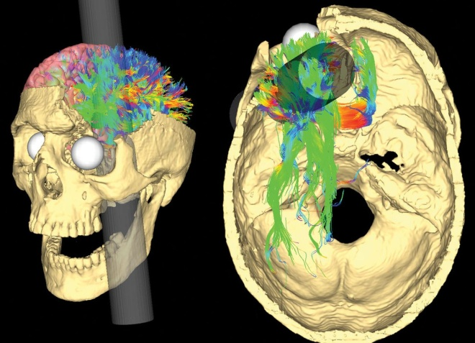
Impact of this accident on modern understanding? Why still relevant?
By separating the limbic system from the frontal lobe and the resulting change in Gage’s character, it demonstrated the roles of specific regions of the brain.
“He is the textbook case of a post-traumatic personality change.”

Slide 11
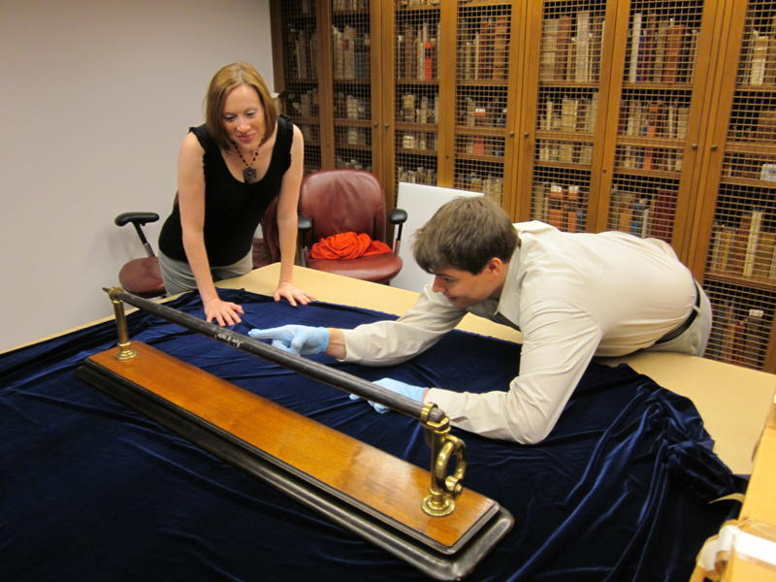
Where is his trophy now?
Warren Museum at Harvard University
A monument to how physical changes in the brain affect behavior

Slide 12
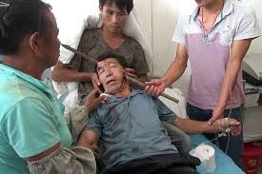
1 Most shocking…
Not the only time it’s happened. After a 2011 bombing incident in Oslo…

