Slide 1
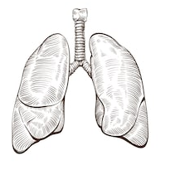
Respiratory System Anatomy & Physiology questions

Slide 2
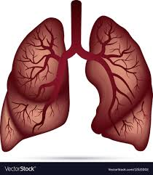
1. How is the right lung different from the left?
The right lung has three lobes and the left lung has only two.
Right Superior lobe
Left Superior lobe
Right Middle lobe
Left Inferior lobe
Right Inferior lobe

Slide 3
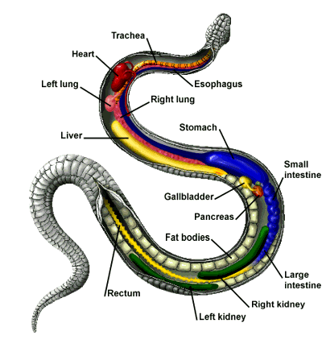
Fun Fact #1: Snakes have two lungs, but they are completely asymmetrical. As snakes evolved into their cylindrical shape (from lizard-like ancestors), the right lung elongated into the main respiratory organ while the left lung became almost vestigial.

Slide 4
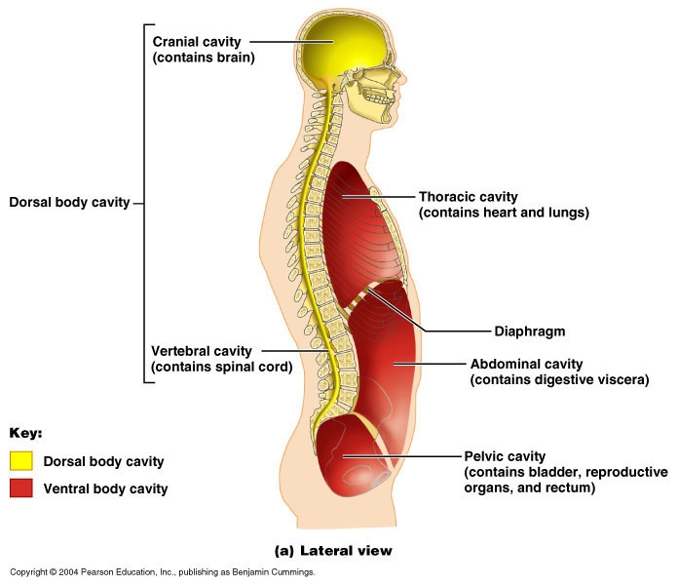
2. What is the empty space in which the lungs rest?

Slide 5
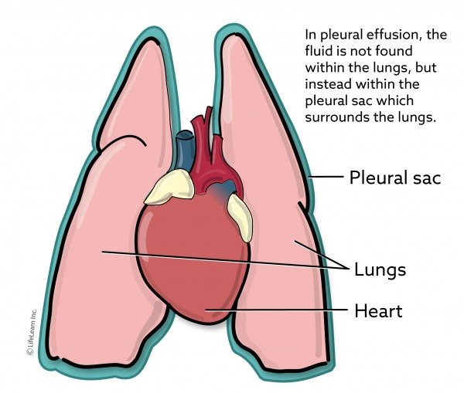
3. What thin membrane covers each lung?

Slide 6
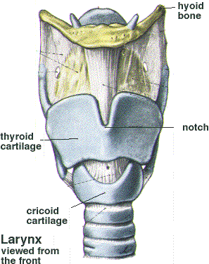
4. What is this structure called?
a. The LARYNX (best answer), but is also called the Voice Box, or even the “Adam’s apple.”

Slide 7
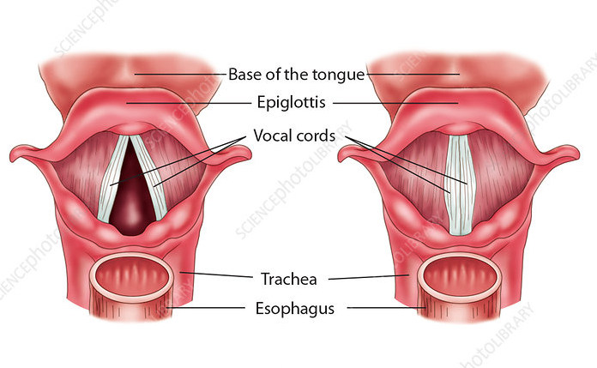
What does the LARYNX do? (actually two things)
b.
It houses the vocal cords,
so VOICE PRODUCTION.
Tra La La

Slide 8
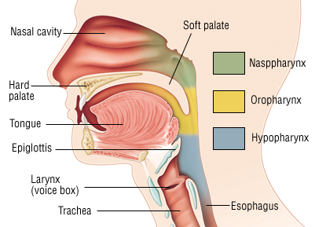
The larynx also provides an open airway to the lungs, but can switch it off (remember the epiglottis) when swallowing.
The epiglottis is part of the larynx.

Slide 9
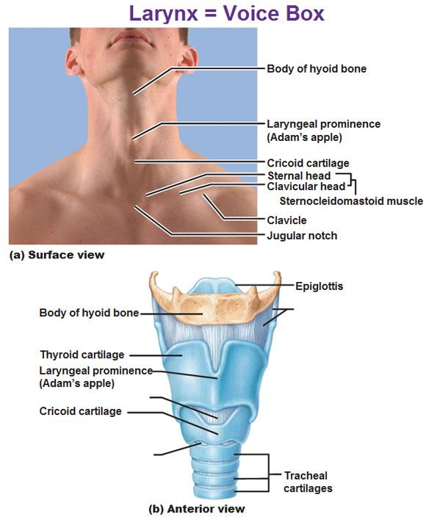
Fun fact #2: The term “Adam’s apple” refers to the LARYNGEAL PROMINENCE. While going through puberty, male sex hormones stimulate the growth of this structure, so it’s very noticeable in some guys. But the term is misleading because everyone has one (it’s just less obvious in girls.)

Slide 10
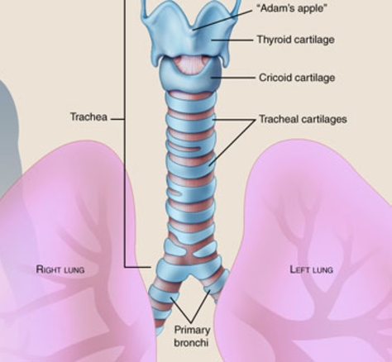
5. The trachea is a flexible tube about 10-12 cm long (four inches.) It’s reinforced by rings of cartilage that prevent it from collapsing. Also, it’s located anterior to the esophagus.

Slide 11
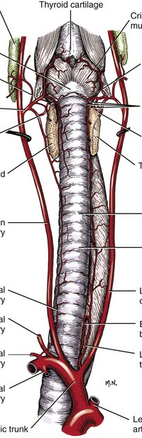
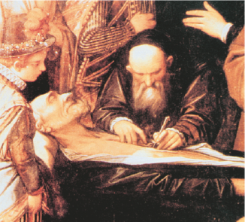
Fun fact #3: The term “trachea” means “rough”, and the windpipe got this name because early anatomists thought it was a rough-walled artery.

Slide 12
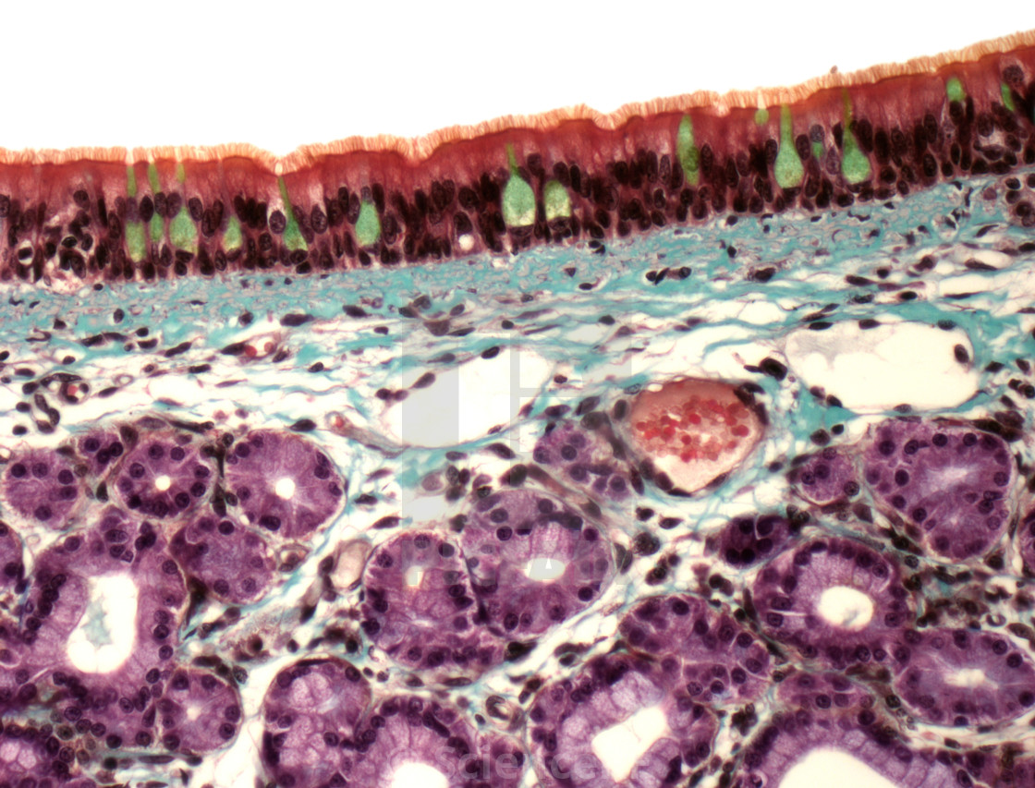
6. What type of tissue coats the inner lining of the trachea?
CILIATED PSEUDOSTRATIFIED EPITHELIUM
(with occasional Goblet Cells)

Slide 13
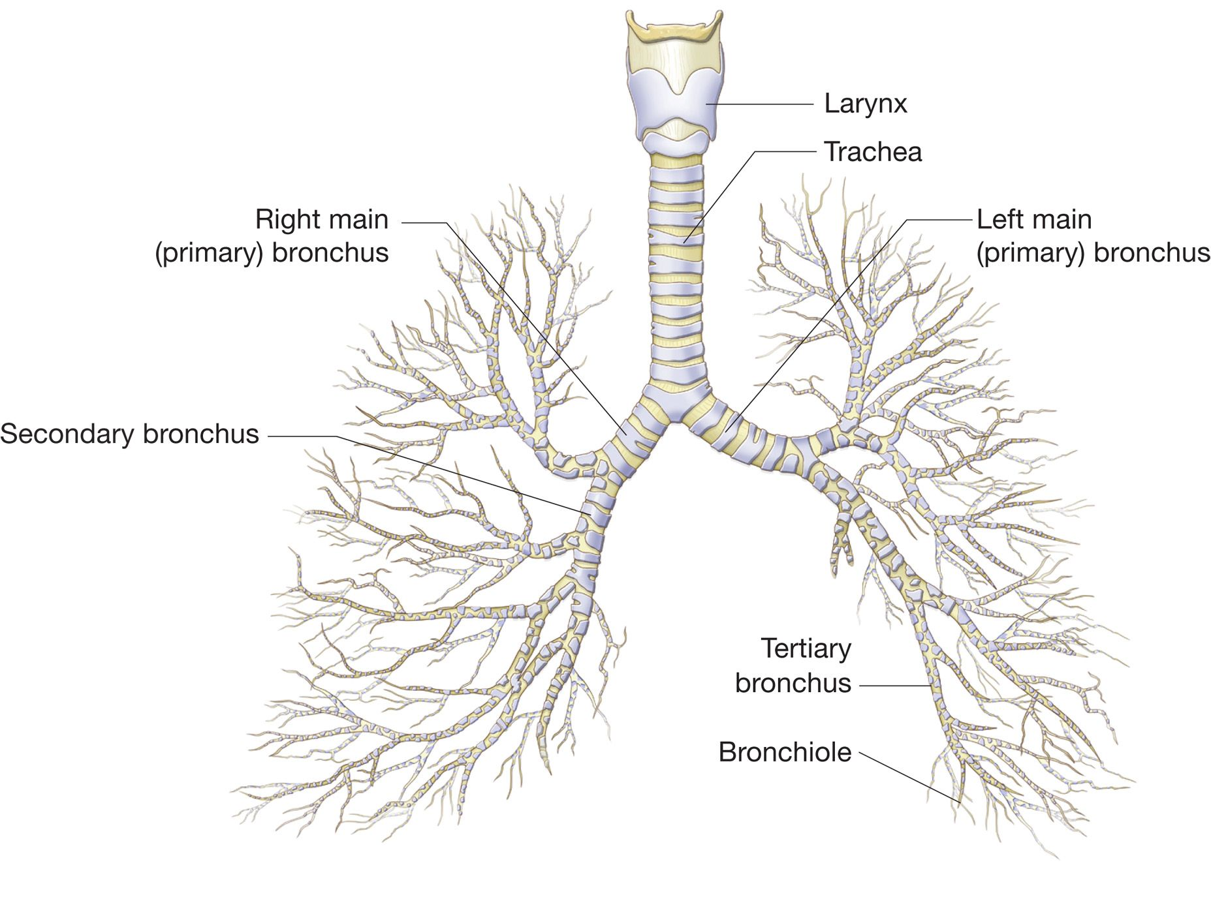
7. The primary bronchi branch into a. The secondary bronchi, and then into… b. The tertiary bronchi.

Slide 14
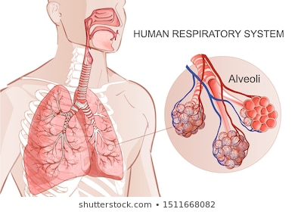
8. The little bubbly-looking air sacs are called alveoli (alveolus singular.) This is where the actual gas exchange takes place (note the blood vessels.)

Slide 15
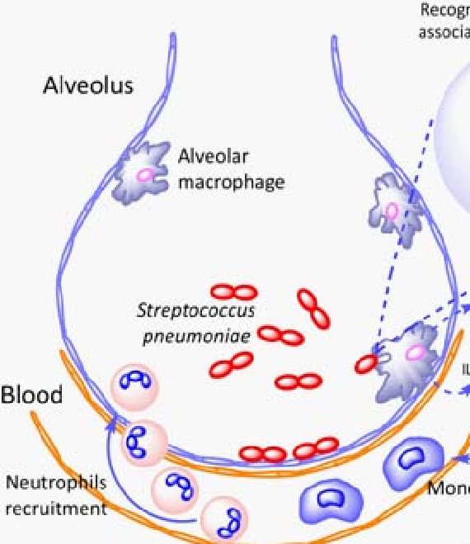
Fun fact #4 Each of our tiny alveoli is home to hundreds of macrophages ready to fight off infection. But they eventually die, and since the alveoli are like dead end streets, they have to be removed. Where do they go? Remember, your entire respiratory tract is lined with a film of mucus that moves upwards, being propelled by cilia. Once in the larynx, a collection of mucus causes you to clear your throat and then swallow. As a result, we each swallow about two million deceased macrophages per hour!

Slide 16
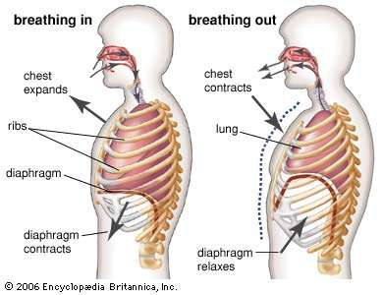
9. When your diaphragm contracts, it moves inferiorly. This causes your ribcage to expand. This, in turn, causes your lungs to stretch. That causes the INTRAPULMONARY PRESSURE to drop (the creation of a vacuum) which causes inhalation.

Slide 17
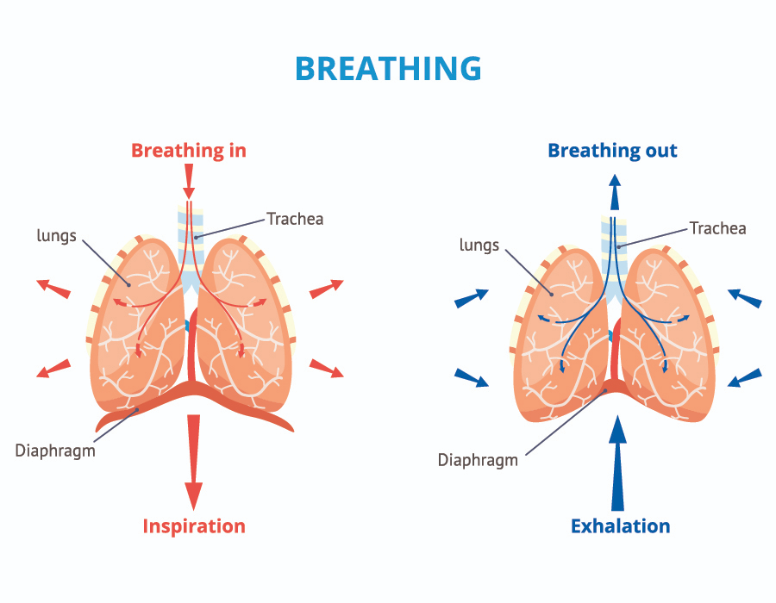
10. The whole point of breathing is GAS EXCHANGE. Our cells need oxygen to drive cellular respiration (which gives us energy), and to eliminate carbon dioxide (a waste product.)

